Slide 1


Group Presentation
Nature’s Call
Poster Design
Presentation Group : Group 5
Notes:
亮亮图文旗舰店
https://liangliangtuwen.tmall.com

Slide 2
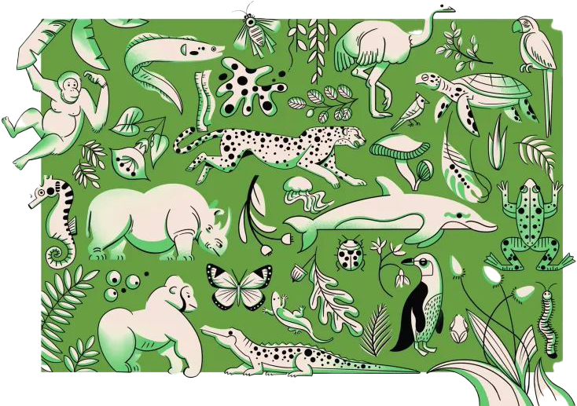
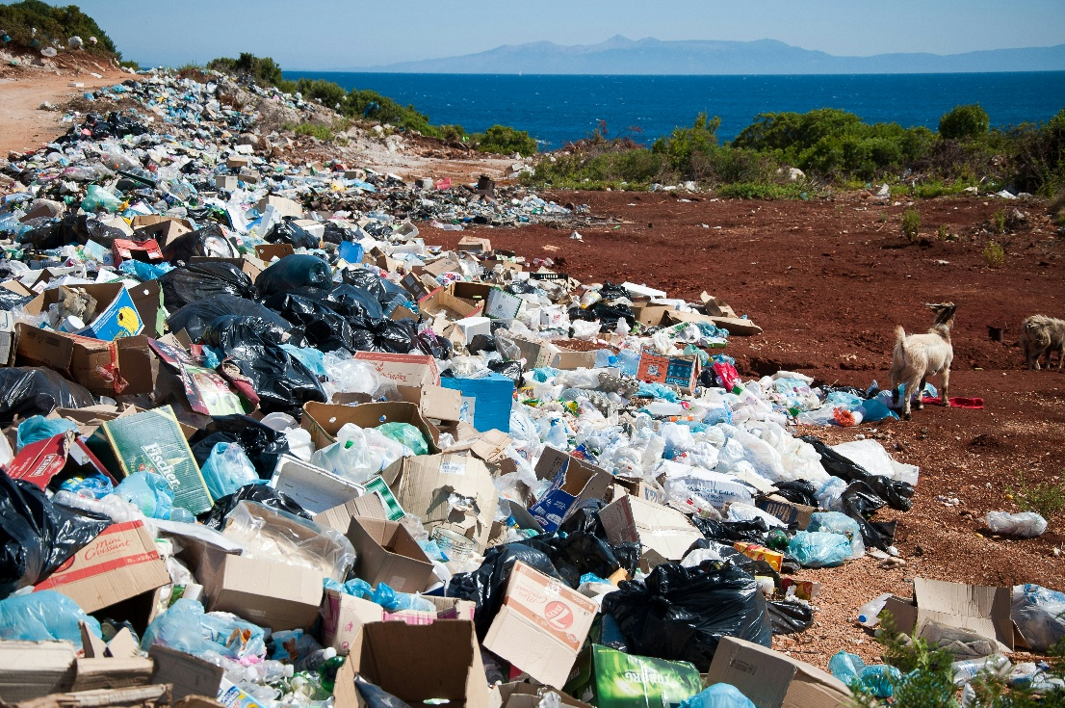
Environmental Problems
Environmental problems include climate change, pollution, deforestation, and biodiversity loss. Currently, global temperatures are rising, plastic and air pollution persist, forests are shrinking, and many species face extinction due to human activity.

Slide 3
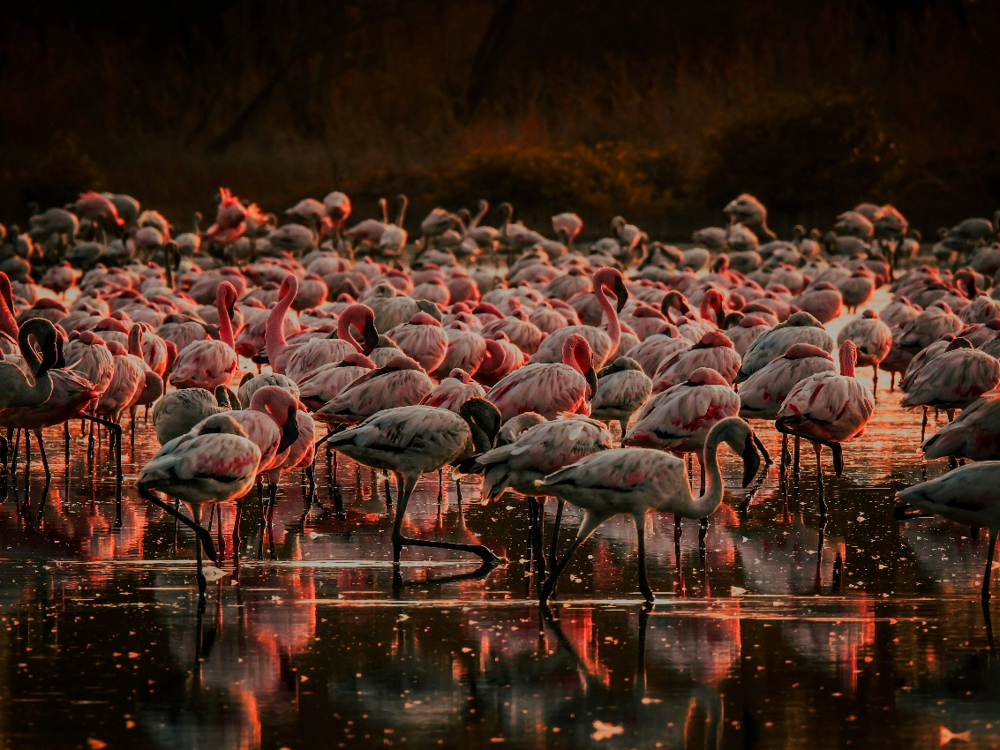
Address them!
Reduce emissions
Cut pollution
Promote awareness
Global cooperation
And that's what nature is calling. Not only does the call mean “the power of nature to heal people”, but it also call on us to improve the poor situation.
We should answer the nature’s call and take action in no time.

Slide 4
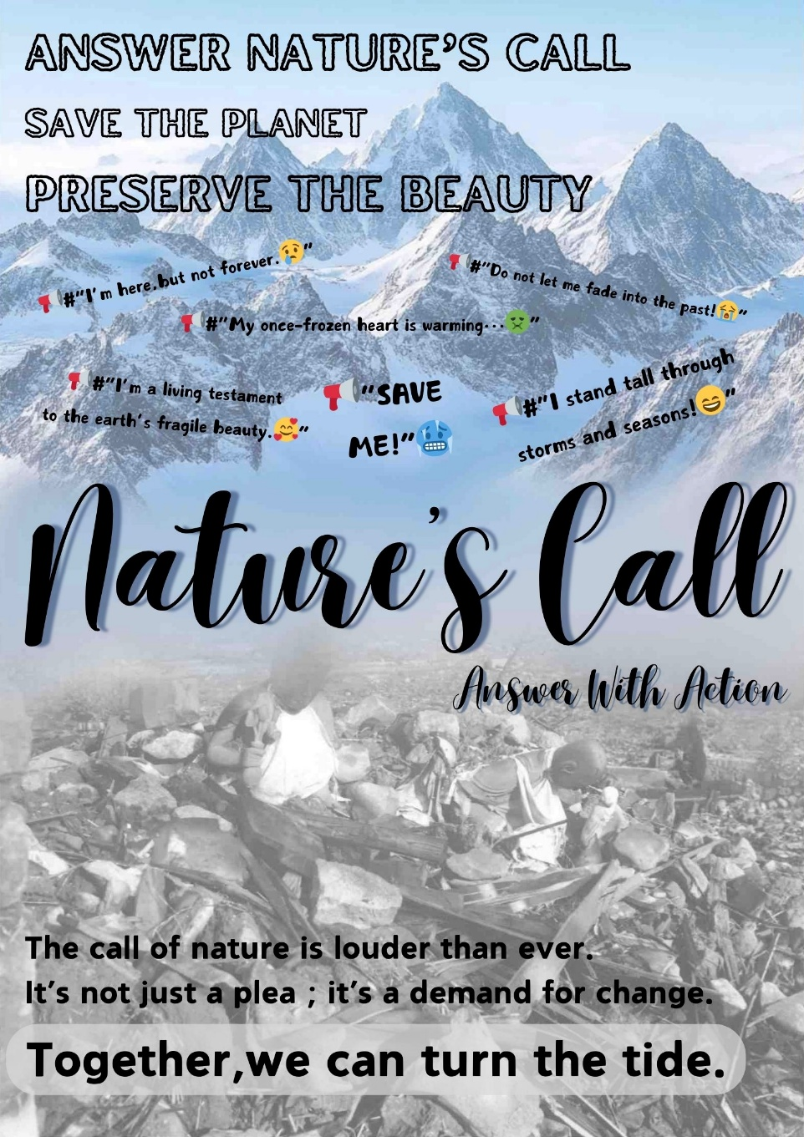
Poster Design
The text at the top, "ANSWER NATURE'S CALL"
The background features a powerful contrast between the majestic, snow-covered mountains and white image of deforestation debris.
The use of hashtags like "#I'm here, but not forever," and others create a sense of urgency and personal connection
The title "Nature's Call" in bold
The final message at the bottom, "The call of nature is louder than ever. It's not just a plea; it's a demand for change. Together, we can turn the ride."

Slide 5
THANK YOU!
PPT Production：Jiang Hongyu & Fan Hangtao
presentation & PPT modification：He Mingyuan
Copywriting ：Chen Tianle
Poster Production：Sun Zhou
Notes:
亮亮图文旗舰店
https://liangliangtuwen.tmall.com

